Slide 1
Project Title: Efficient Courier Tracking System
Your Name
Roll Number
Project Guide: Teacher Name

Slide 2
Introduction
Courier service providers usually have a very large network across countries. A courier goes through several places including distribution centre and delivered using transportation services like, aero plane, ship, road transport etc.
Customer can track his/her order, till where the courier has been reached just by logging in and entering courier number to track the location of the package. Here we propose a dedicated courier tracking system where customer may check the status and location of his/her courier.
Customers may login in to the server in order to enter their unique courier tracking number. On entering the number system, they get the last recorded status of that particular package and shows this data to the user. The user may now track his package as and when needed.

Slide 3
Objective
The actual problem is to maintain different database for a courier company whose main purpose is to provide parcel services for their customers for different places, and maintain details of all the transactions, employees and address details. In the manual system it is difficult to maintain data and generating different reports according to requesting transaction. In the present courier system always they have to take source as well as destination information which contains address details, parcel contents details etc. By keeping all the above activities we are developing a system named as “EFFICIENT COURIER TRACKING SYSTEM”. In this automation system we are maintaining company as well as customer details related to courier service and courier management that contains the user as well as admin details.

Slide 4
Proposed Methodology
Software Development Life Cycle (SDLC) is a process used by the software industry to design, develop and test high quality softwares. The SDLC aims to produce a high-quality software that meets or exceeds customer expectations, reaches completion within times and cost estimates.
Model Used: Prototype Model

Slide 5
Use of Prototype model
The Prototyping Model should be used when the requirements of the product are not clearly understood or are unstable. It can also be used if requirements are changing quickly. This model can be successfully used for developing user interfaces, high technology software-intensive systems, and systems with complex algorithms and interfaces. It is also a very good choice to demonstrate the technical feasibility of the product.
Technology Used:
Below are the some of the main technologies used for the development of the project:
Python
Django Framework
MySql

Slide 6
Hardware/Software Requirements
Software:
A set of programs associated with the operation of a computer is called software.
Software is the part of the computer system which enables the user to interact with several physical hardware.
Designing Frontend: HTML,CSS, Java Script, Django Framework
Backend (Database): MySql
Hardware:
The collection of internal electronic circuits and circuits and external physical devices used in building a computer is called Hardware.
The minimum hardware requirement specification for developing this project is as follows:
RAM: 512 MB (minimum)
Space Requirement: 1 GB

Slide 7
Modules
Admin:
View User: Admin can view all information about the user.
View package status: Admin can view the package status.
User:
Login: User can login his account using id and password.
View package status: User can view the package status.
Request For Courier Service
In this module, User is making a request to admin that they need to send the courier with the details.
Users also add the details of courier like sender name, sender address, material weight, material type and their own details.
Then admin can view the request from user and then view their details.

Slide 8
Modules contd:
Allocate Service
Admin is viewing the details and they can allocate it to the particular address to be received by user.
Once they received the courier from the user then they can allocate the delivery person to deliver the item to particular address.
Admin will be able to add/edit details about the courier.
Updation of Courier Status
In this module, Service Person that is Delivery Person is about to update the status of their own. This will be done through admin.
Once they receive the courier from user they also made a updation about order received.
Tracking the Courier
This is user side module. User can Track their courier by id which is allocated to the transportation that also intimated them previously
There is another way of tracking also available to view the updation about their courier service.
Admin will be able to add tracking details and description.

Slide 9
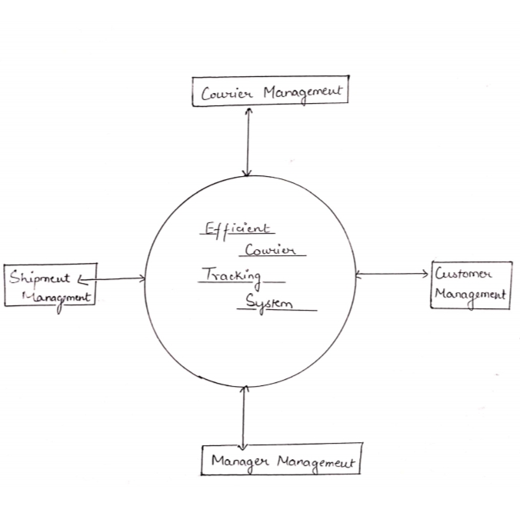
Data Flow Diagram (zero level)

Slide 10
One Level DFD

Slide 11
One level DFD (contd)

Slide 12
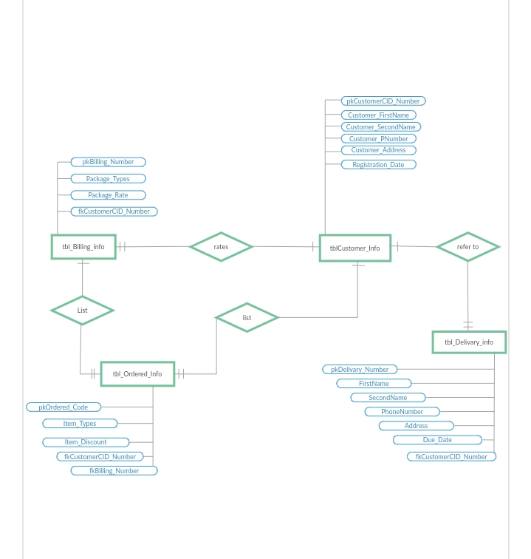
cid_no, billing_no are primary keys

Slide 13
Advantages
Receiver can track his courier or ordered goods.
This system can be used in several different domains for tracking goods sent by someone.
It even helps the authority to keep an eye on sent goods.
Limitation
Authority at every point has to manually enter the location of the goods.
User does not get the exact location of its order.
Application (Future Scope)
This can be used by Online Shopping companies to provide online tracking of order to their customers.
This System can also be used by Courier companies to let the receiver track his courier.

Slide 14
References
Rajib Mall, Fundamental of Software Engineering, Third Edition, PHI,2009
Elmasri Nevathe, “Fundamentals of Database Systems”.Third Edition, Pearson Publication,2002
https://www.google.com/amp/s/www.geeksforgeeks.org/software-engineering-prototyping-model/amp/
https://www.shiprocket.in/blog/courier-parcel-package-tracking-system-working/
https://www.geeksforgeeks.org/software-engineering-software-design-process/

Slide 15
THANK YOU!

